Slide 1
DISTRICT 16
LECTURE SERIES
Endplays
By: Daniel Jackson – March 29, 2025

Slide 2
What is an endplay?
From Wikipedia:
An endplay in bridge is a tactical play where a defender is put on lead at a strategic moment and then must make a play that loses one or more tricks. Most commonly, the losing play either constitutes a free finesse or gives declarer a ruff and discard.

Slide 3
Concepts from definition…..
Free Finesse
Ruff and Discard
Frozen Suit

Slide 4
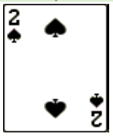
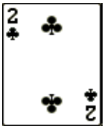
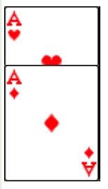
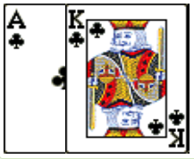
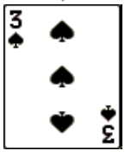
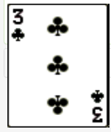
Ruff and Discard
Spades are trumps
What happens if declarer is on lead?
What happens if West is on lead?

Slide 5
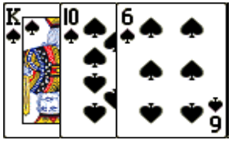
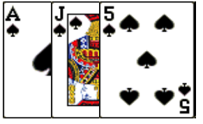
Free Finesse
What happens if declarer is on lead?
What happens if the defenders are on lead?

Slide 6
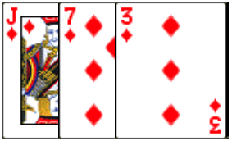
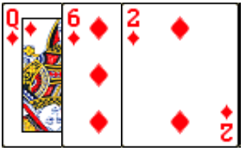
Frozen Suit
What happens if declarer is on lead?
What happens if the defenders are on lead?

Slide 7
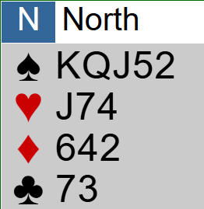
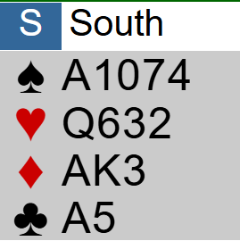
Contract: 3 Spades, lead King of Clubs
How the play should go

Slide 8
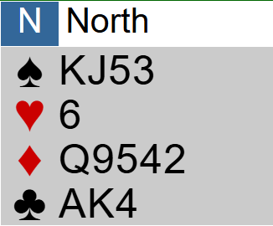
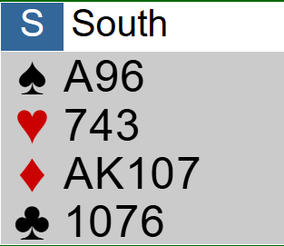
Contract: 5 Diamonds, Lead: Ace of Hearts
Auction note: West overcalled 1 heart, East raised preemptively
With an endplay... Without an endplay...
What if trumps are 3-1?

Slide 9
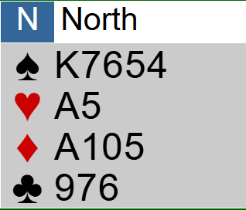
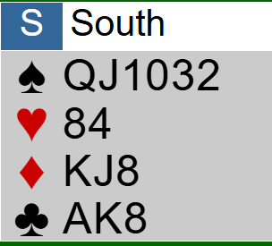
Contract: 4 Spades, Lead: Queen of Hearts
With an endplay... Without an endplay...

Slide 10
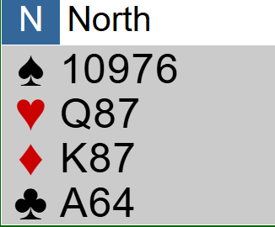
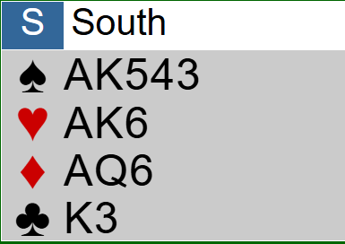
Contract: 6 Spades, Lead: Jack of Hearts
Can you make it on a bad spade split?

Slide 11
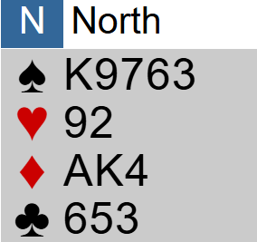
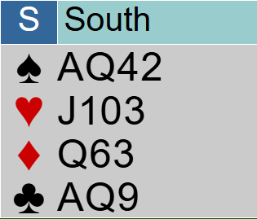
Contract: 4 Spades, lead Queen of hearts
With an endplay... Without an endplay...

Slide 12
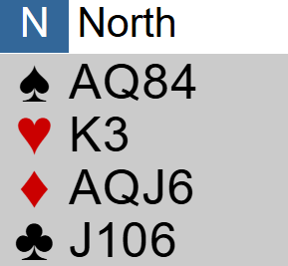
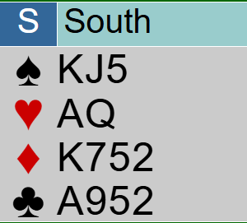
Contract: 6NT Lead: 8 of hearts
Auction note: East preempted in hearts
With endplay... Without endplay...

Slide 13
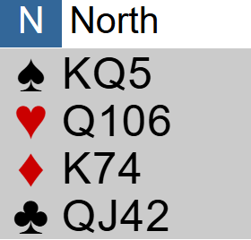
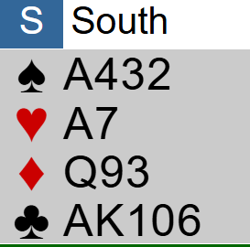
Contract: 3NT Lead: small heart Auction note: North deals, East overcalls 1 club with 2NT, 2 lower unbid
Without counting... Counting cards...

Slide 14
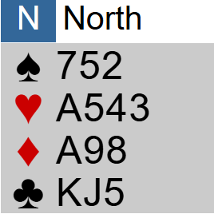
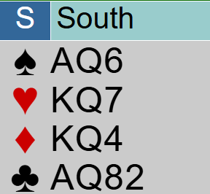
Contract: 6NT Lead: Jack of hearts
Without counting... Counting cards...

Slide 15
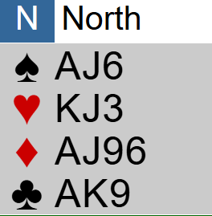
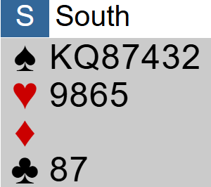
Real hand #1: Contract 4S, lead small club
Auction note: East opened one club.
Without endplay... With endplay...

Slide 16
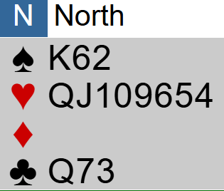
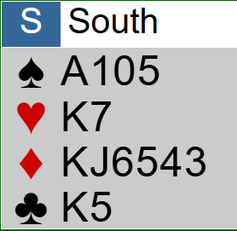
Real hand #2: Contract 4H, lead small club
With an endplay...
Real hands are messy! ☺

Slide 17
Real Hand #3: Two Confessions
Contract: 3NT, lead 3 of clubs
Link to Hand: BBO

Slide 18
QUESTIONS ??
Feel free to contact me by email:
djackson3789@hotmail.com

Slide 19
THANK YOU ♥️

